Slide 1

Climate Forecasting System Based on Deep Learning and Multi-Sensors
Uddin Sahab
Supervisor: He Gang
Southwest university of science and technology
Date: 2025/11/13

Slide 2
Agenda
Introduction
Research Objectives
Research Questions
Methodology
Key Findings
Results and Discussion
Future Work
Achievements
References
Conclusion

Slide 3
Introduction
Background: Climate forecasting is vital for disaster management, agriculture, and infrastructure planning. It helps predict weather patterns, minimize the impact of extreme events, optimize agricultural practices, and strengthen infrastructure resilience, enabling better decision-making and long-term planning.
Problem: Traditional forecasting methods struggle to accurately predict climate patterns because they can't effectively handle the complex and nonlinear nature of climate data. These methods often miss important relationships in the data, leading to less reliable forecasts.
Solution: A deep learning-based climate forecasting system that integrates multi-sensor data for accurate short-term temperature predictions.

Slide 4
Research Objectives
Develop a leak-free preprocessing pipeline for multi-sensor data.
Compare deep learning models for forecasting.
Optimize the LSTM model for stable generalization and performance.
Deploy the best model via a Flask-based web application for practical use.

Slide 5

Research Questions
How to build a leak-free preprocessing pipeline?
How do different sequence models compare in terms of forecasting accuracy and stability?
Model Evaluation: Using MAE, RMSE, R² to assess prediction accuracy
How to deploy the LSTM model for real-time forecasting using Flask?

Slide 6
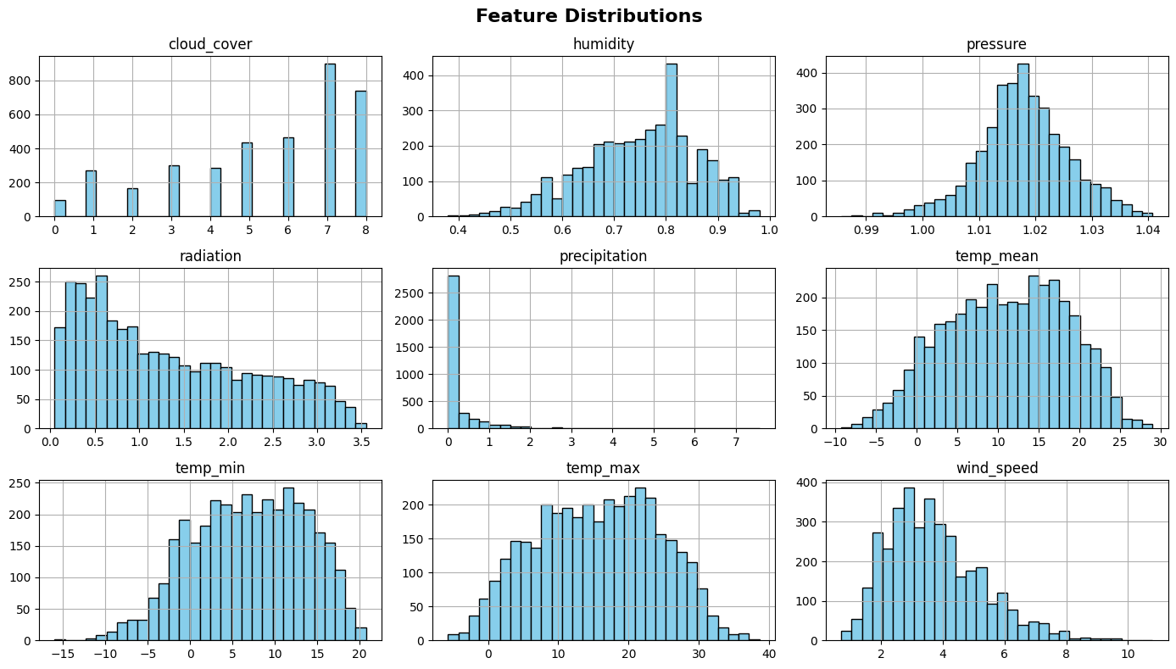
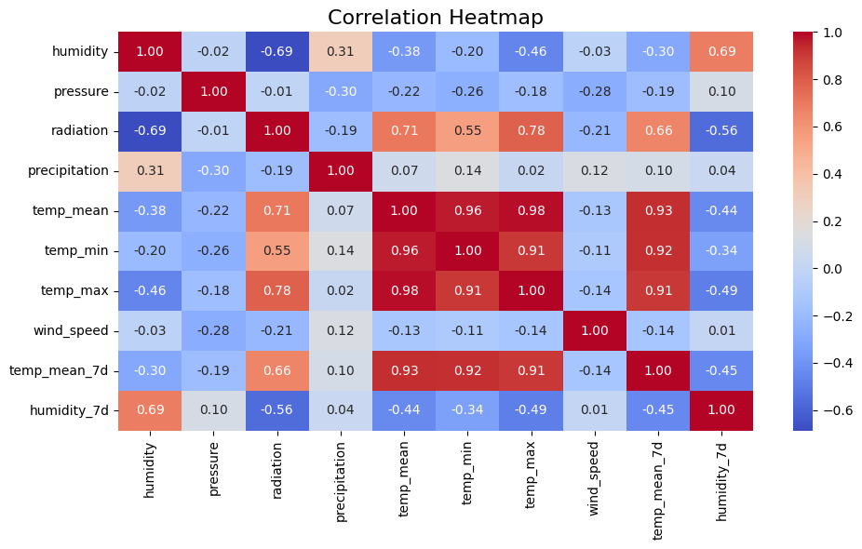
Methodology
Dataset Description
Data Source: The dataset used in this study was sourced from Kaggle and contains multi-sensor weather data, including temperature, humidity, pressure, wind speed, radiation, and precipitation. It was customized to meet the needs of the climate forecasting system.
Data Preprocessing:
Data Cleaning & Alignment: Raw data was cleaned and aligned to ensure consistency and accuracy across all sensors.
Handling Missing Values & Outliers: Missing data was imputed, and outliers were identified and removed to prevent distortion of model performance.
Time-Series Segmentation: The data was divided into overlapping sliding windows to enable the model to learn from sequential patterns in the climate data.

Slide 7
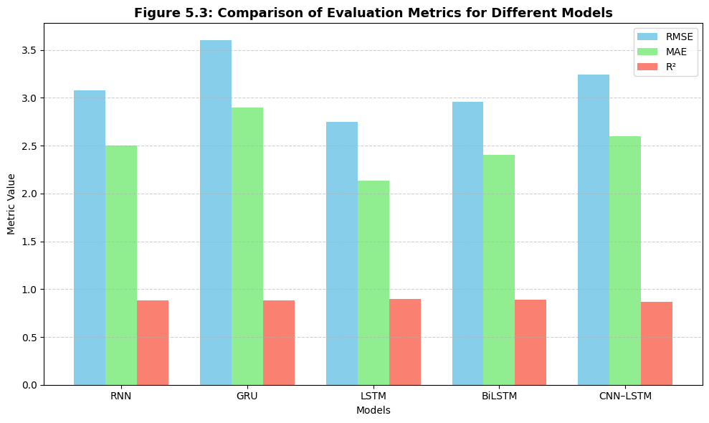
Model Selection
Model | MAE(°C) | RMSE (°C) | R² Score
RNN | 2.5 | 3.085 | 0.879
GRU | 2.9 | 3.6 | .88
CNN-LSTM | 2.6 | 3.243 | 0.866
BiLSTM | 2.4 | 2.958 | 0.89
LSTM (Proposed) | 2.137 | 2.75 | 0.905
I trained and compared several models RNN, LSTM, GRU, BiLSTM, and CNN-LSTM using the same dataset and preprocessing steps. The LSTM model achieved the best accuracy in predicting short-term temperature, making it the most reliable and stable choice for this project. Therefore, LSTM was selected as the final model for deployment.

Slide 8
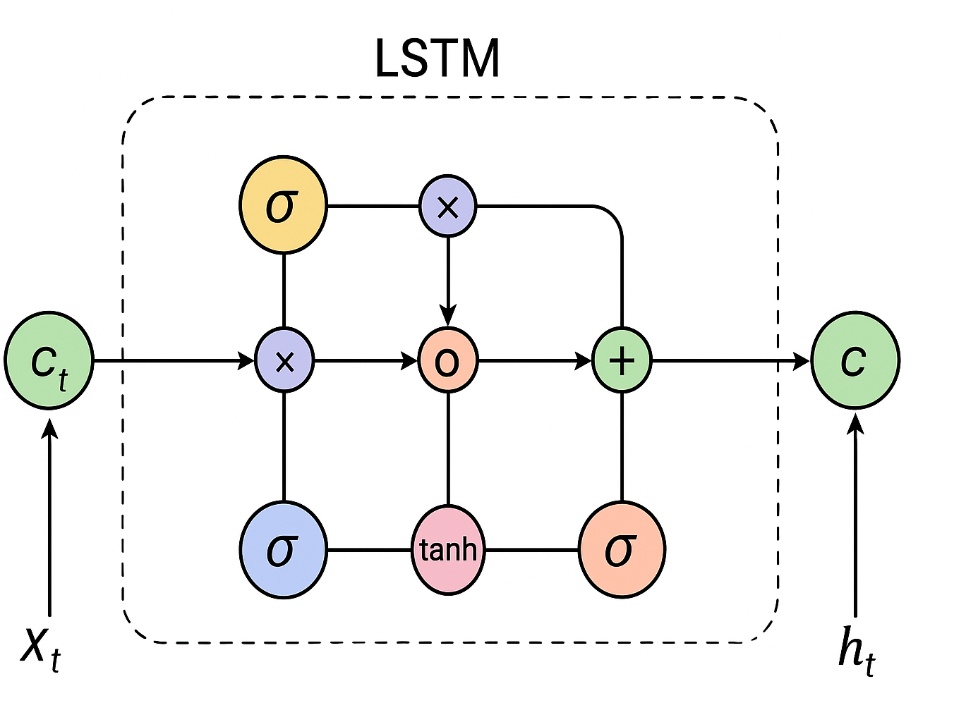
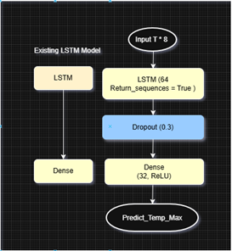
Model Architecture
The LSTM model consists of the following layers:
  Input Layer:
  Takes time-series data, where each timestep includes climate features (temperature, humidity, etc.).
  LSTM Layer:
  The first LSTM layer has 64 units to capture temporal dependencies in the data.
  Dropout Layer:
  A dropout rate of 0.3 to prevent overfitting and enhance generalization.
  Dense Layer:
  Contains 32 units with a ReLU activation function to learn complex patterns.
  Output Layer:
The final layer with 1 unit and a linear activation function to predict the temperature.
This architecture enables the model to effectively learn short- and long-term dependencies in climate data for accurate temperature forecasting.

Slide 9
Comparison Table
Author (Year) | Model Used | Dataset Type | Target Variable | Accuracy (%)
Zhang et al. (2021) | CNN–LS TM | Satellite + ground Sensors | Rainfall | 86.5
Rahman et al. (2022) | GRU | Regional climate dataset | Humidity | 87.2
Li et al. (2023) | BiLSTM | Time-series dataset | Wind speed | 88.1
Chen et al. (2024) | CNN–LS TM | Multi-sensor dataset | Temperature | 88.7
Guo et al. (2024) | CNN–LS TM | Meteorological station data | Minimum temperature | 89.0
Proposed (Uddin, 2025) models | LSTM | Multi-sensor data | Maximum temperature (°C) | 90.05

Slide 10
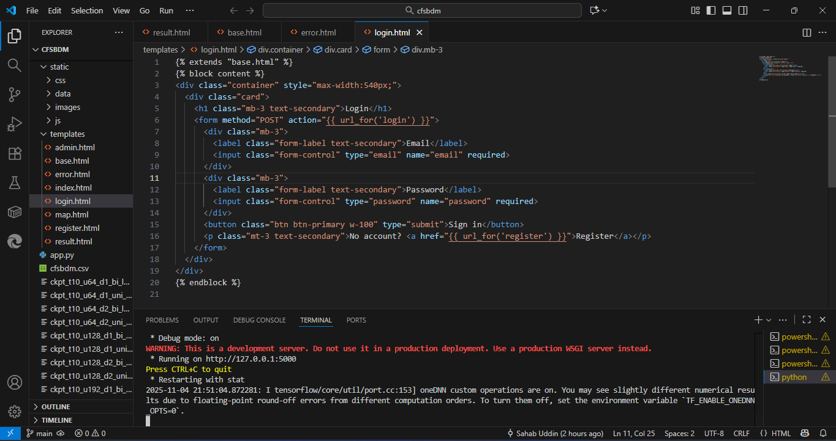
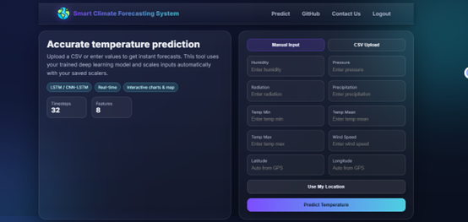
Environmental Setup and Deployment
1. Environmental Setup
The system is built using Python and deployed through a Flask web application. Essential libraries like TensorFlow are used for running the LSTM model, while Pandas handles data processing. The environment is configured to ensure smooth integration between the backend model, data handling, and the user interface, ensuring consistency in preprocessing and accurate forecasting.
2. Deployment
The deployment is carried out using Flask, providing a simple web interface for users to input data. The system supports CSV file uploads for batch predictions and manual input for single-day forecasts. The web application processes the data, runs predictions using the trained LSTM model, and displays the results through clear, interactive charts and numerical outputs for easy interpretation by users.

Slide 11

Project Demonstration Video
This video demonstrates the Climate Forecasting System, showing how it processes input data, runs the LSTM model, and provides real-time temperature predictions through the web interface.

Slide 12
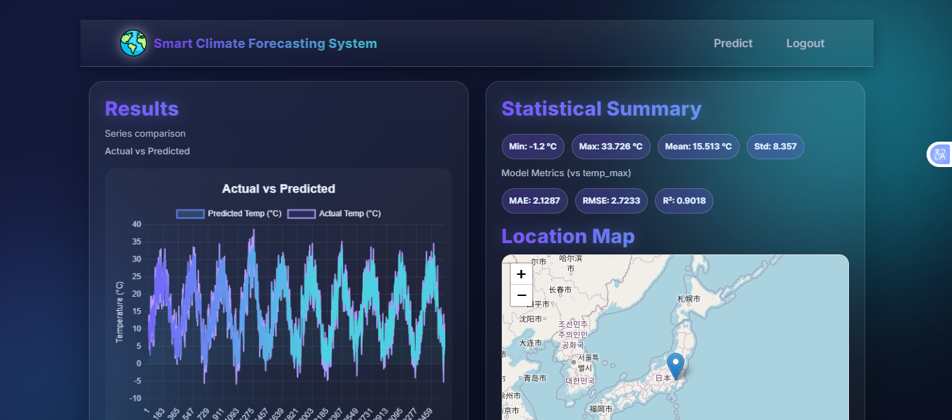
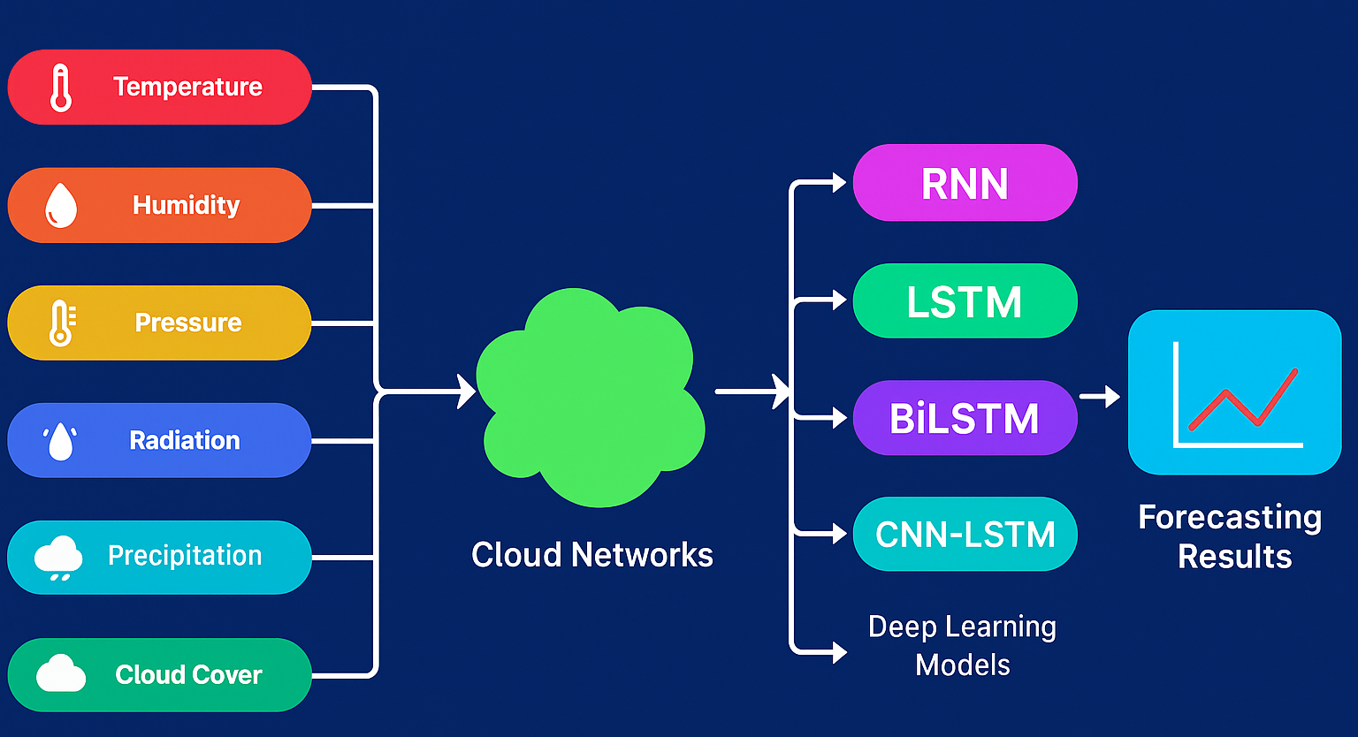
Key Findings
Best Model: LSTM achieved the lowest MAE, RMSE, and highest R² among models.
Deployment: Successful Flask-based deployment that provides real-time predictions and visualizations.
Data Integrity: Strict time-ordered data splits to avoid leakage and ensure reproducibility.

Slide 13
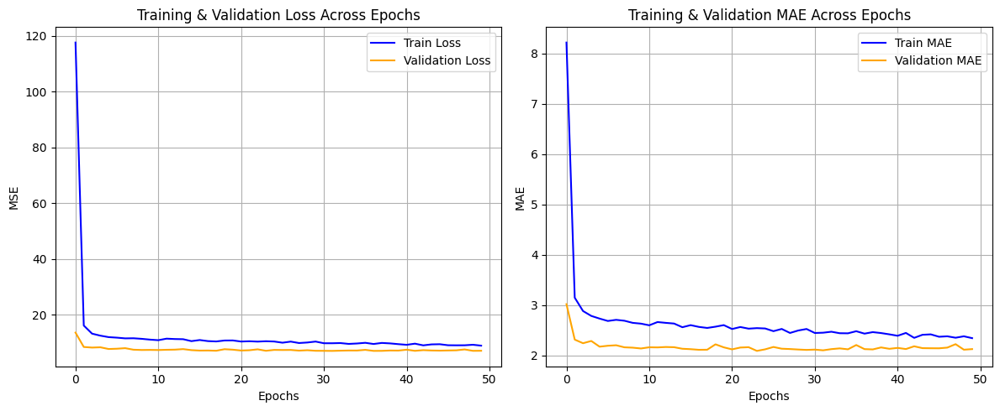
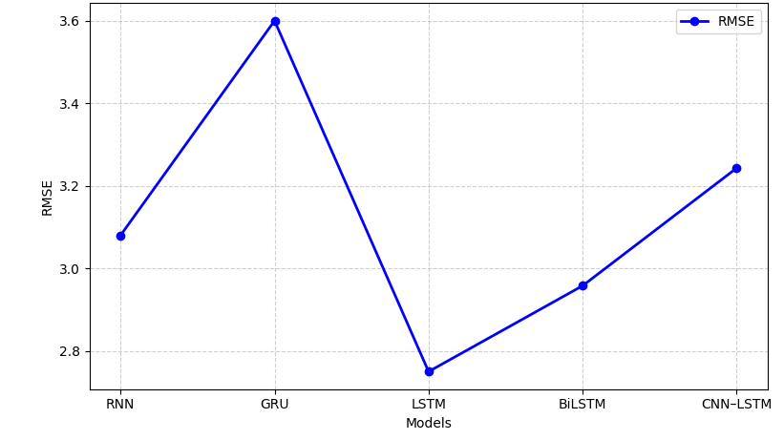
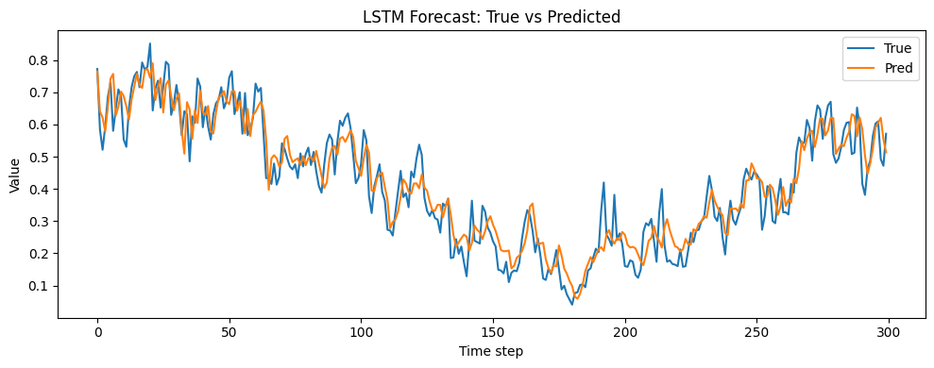
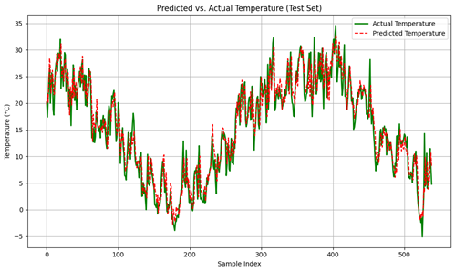
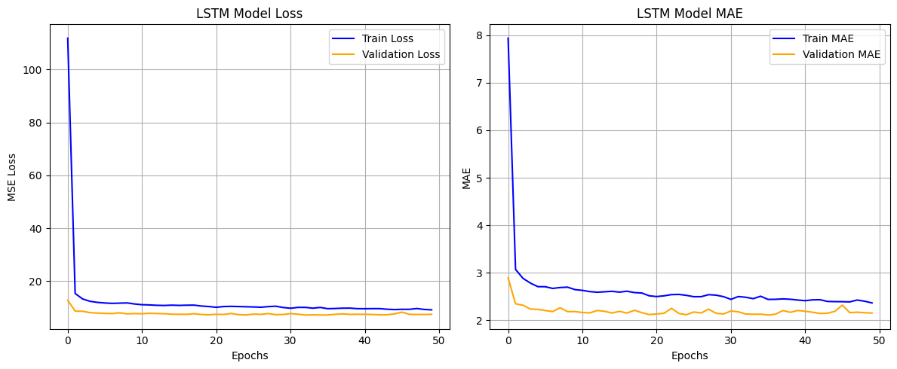
Results and Discussion
Performance Comparison: LSTM outperformed other models in terms of prediction accuracy and stability.
Error Analysis: LSTM exhibited tighter residuals and faster convergence than other models.
User Interface: Web interface for manual input, CSV uploads, and visualized results.

Slide 14

Future Work
Expand the dataset to include multiple regions for better generalization.
Integrate spatial data from satellite or radar imagery.
Experiment with automated hyperparameter optimization techniques.
Improve cloud-based deployment for real-time performance at scale.
Integrate Explainable AI (XAI) for transparency in predictions.

Slide 15
Achievements
Development of an End-to-End System: A fully functional, deep learning-based climate forecasting system.
Practical Application: The system provides actionable insights for agriculture, disaster management, and environmental planning.
Web-Based Deployment: Successfully deployed a user-friendly web application that allows non-experts to interact with the model.
Data-Driven Insights: Demonstrated the effectiveness of multi-sensor data fusion for accurate short-term temperature prediction.

Slide 16


Publications
Social Media Post Detection using NLP and Machine Learning Classifiers
Accepted at the 6th International Conference on IoT-Based Control Networks and Intelligent Systems (ICICNIS 2025), published by IEEE. This paper focuses on NLP and machine learning classifiers for detecting social media posts.
A Deep Learning-Based Approach to Classification of Hematological Diseases
Accepted at the 4th International Conference on Intelligent Computing, Information, and Control Systems (ICOIICS 2025), published by IEEE. This paper explores deep learning for classifying hematological diseases.

Slide 17
References
[1]Jha, M. K., & Dev, M. (2024). Impacts of climate change. In Smart internet of things for environment and healthcare (pp. 139-159). Cham: Springer Nature Switzerland.
[2]Jaber, M. M., Ali, M. H., Abd, S. K., Jassim, M. M., Alkhayyat, A., Aziz, H. W., & Alkhuwaylidee, A. R. (2022). Predicting climate factors based on big data analytics based agricultural disaster management. Physics and Chemistry of the Earth, Parts A/B/C, 128, 103243.
[3]Jaber, M. M., Ali, M. H., Abd, S. K., Jassim, M. M., Alkhayyat, A., Aziz, H. W., & Alkhuwaylidee, A. R. (2022). Predicting climate factors based on big data analytics based agricultural disaster management. Physics and Chemistry of the Earth, Parts A/B/C, 128, 103243
[4]Chen, L., Han, B., Wang, X., Zhao, J., Yang, W., & Yang, Z. (2023). Machine learning methods in weather and climate applications: A survey. Applied Sciences, 13(21), 12019
[5]Blasch, E., Pham, T., Chong, C. Y., Koch, W., Leung, H., Braines, D., & Abdelzaher, T. (2021). Machine learning/artificial intelligence for sensor data fusion–opportunities and challenges. IEEE aerospace and electronic systems magazine, 36(7), 80-93
[6]Krivoguz, D., Ioshpa, A., Chernyi, S., Zhilenkov, A., Kustov, A., Zinchenko, A., ... & Tsareva, P. (2024). Enhancing long-term air temperature forecasting with deep learning architectures. Journal of Robotics and Control (JRC), 5(3), 706-716.
[7]Sahoo, S. (2024). Sensor Fusion and Virtual Sensor Design for Enhanced Multi-Sensor Data Accuracy in Autonomous Systems. International Journal on Smart & Sustainable Intelligent Computing, 1(2), 21-39.
[8]Eddamiri, S., Bassine, F. Z., Hakam, O., Kambiet, P. L. K., & Chehbouni, A. (2025). Applications of artificial intelligence for forecasting and managing extremes. In Climate Change and Rainfall Extremes in Africa (pp. 91-113). Elsevier.
[9]Chen, L., Han, B., Wang, X., Zhao, J., Yang, W., & Yang, Z. (2023). Machine learning methods in weather and climate applications: A survey. Applied Sciences, 13(21), 12019.
[10]Jagannathan, K., Pathak, T. B., & Doll, D. (2023). Are long-term climate projections useful for on-farm adaptation decisions?. Frontiers in Climate, 4, 1005104.

Slide 18

Acknowledgments
I sincerely thank my supervisor for their guidance and my collaborators for their contributions. I also appreciate the support from my colleagues, family, and friends throughout this project.

Slide 19

Thank you for your time and attention.
I welcome any questions or feedback

